Slide 1
C++ Plus Data Structures
Nell Dale
David Teague
Chapter 7
Programming with Recursion

Slide 2
Recursive Function Call
A recursive call is a function call in which the called function is the same as the one making the call.
In other words, recursion occurs when a function calls itself!
We must avoid making an infinite sequence of function calls (infinite recursion).
Notes:
재귀함수
문제 해결을 위해서 자신을 호출하는 함수
주의 사항: 끝 없는 함수 호출을 막아야 한다.

Slide 3
Finding a Recursive Solution
Each successive recursive call should bring you closer to a situation in which the answer is known.
A case for which the answer is known (and can be expressed without recursion) is called a base case.
Each recursive algorithm must have at least one base case, as well as the general (recursive) case
Notes:
순환해 구하기
연속적인 순환호출은 해답이 알려진 상황에 접근하게 해야 한다.
해가 알려진 상황(Base case)에 도달하면 거기서 부터 역으로 회귀하면서 단계적으로 해를 구한다.
Base case에 도달하도록 연속적으로 순환호출을 수행하는 것을 general case라 한다.
각 순환알고리즘은 순환적인 general case 뿐만 아니라 적어도 하나의 base case를 가져야 한다.

Slide 4
General format for many recursive functions
if (some condition for which answer is known)
// base case
solution statement
else // general case
recursive function call
SOME EXAMPLES . . .
Notes:
대부분의 순환함수들을 위한 일반적인 포멧
If 순환이 끝나는 조건(base case)테스트 가 TRUE 이면
해를 리턴하는 statement
FALSE 이면
순환호출

Slide 5
Writing a recursive function to find n factorial
DISCUSSION
The function call Factorial(4) should have value 24, because that is 4 * 3 * 2 * 1 .
For a situation in which the answer is known, the value of 0! is 1.
So our base case could be along the lines of
if ( number == 0 )
return 1;
Notes:
- 계승을 구할 때 해가 알려진 경우는? → Base Case

Slide 6
Writing a recursive function to find Factorial(n)
Now for the general case . . .
The value of Factorial(n) can be written as
n * the product of the numbers from (n - 1) to 1,
that is,
n * (n - 1) * . . . * 1
or, n * Factorial(n - 1)
And notice that the recursive call Factorial(n - 1) gets us “closer” to the base case of Factorial(0).

Slide 7
Recursive Solution
int Factorial ( int number )
// Pre: number is assigned and number >= 0.
{
if ( number == 0) // base case
return 1 ;
else // general case
return number + Factorial ( number - 1 ) ;
}

Slide 8
Three-Question Method of verifying recursive functions
Base-Case Question: Is there a nonrecursive way out of the function?
Smaller-Caller Question: Does each recursive function call involve a smaller case of the original problem leading to the base case?
General-Case Question: Assuming each recursive call works correctly, does the whole function work correctly?
Notes:
순환 함수를 확인하는 Three-Question Method
함수를 나가는 비순환적인 길이 있는가? 즉 순환이 끝나는 조건이 있는가?
각 순환함수호출이 base case로 인도할 수 있도록 원래문제를 좀더 작은 case로 분할해 가는가?
각 순환호출이 정확하게 동작한다고 가정했을 때, 전체 함수가 정확하게 동작하는가?

Slide 9
Another example where recursion comes naturally
From mathematics, we know that
2⁰ = 1 and 2⁵ = 2 * 2⁴
In general,
x⁰ = 1 and x^{n} = x * x^{n-1}
for integer x, and integer n > 0.
Here we are defining x^{n} recursively, in terms of x^{n-1}

Slide 10
// Recursive definition of power function
int Power ( int x, int n )
// Pre: n >= 0. x, n are not both zero
// Post: Function value = x raised to the power n.
{
if ( n == 0 )
return 1; // base case
else // general case
return ( x * Power ( x , n-1 ) ) ;
}
Of course, an alternative would have been to use looping
instead of a recursive call in the function body.
10

Slide 11
struct ListType
struct ListType
{
int length ; // number of elements in the list
int info[ MAX_ITEMS ] ;
} ;
ListType list ;

Slide 12
Recursive function to determine if value is in list
PROTOTYPE
bool ValueInList( ListType list , int value , int startIndex ) ;
Already searched Needs to be searched
74 36 . . . 95
75 29 47 . . .
list[0] [1] [startIndex]
[length -1]
index
of
current
element
to
examine

Slide 13
bool ValueInList ( ListType list , int value , int startIndex )
// Searches list for value between positions startIndex
// and list.length-1
// Pre: list.info[ startIndex ] . . list.info[ list.length - 1 ]
// contain values to be searched
// Post: Function value =
// ( value exists in list.info[ startIndex ] . . list.info[ list.length - 1 ] )
{
if ( list.info[startIndex] == value ) // one base case return true ;
else if (startIndex == list.length -1 ) // another base case
return false ;
else // general case
return ValueInList( list, value, startIndex + 1 ) ;
}
13

Slide 14
“Why use recursion?”
Those examples could have been written without recursion, using iteration instead. The iterative solution uses a loop, and the recursive solution uses an if statement.
However, for certain problems the recursive solution is the most natural solution. This often occurs when pointer variables are used.
Notes:
순환을 이용한 함수들은 순환대신에 loop를 사용하는 iteration을 이용하여 작성될 수 있다.
순환해가 가장 자연스러운 문제가 있는데 많은 경우에 포인터 변수를 사용할 때 발생한다.pass by value를 사용할 때는 overhead가 크다.

Slide 15
struct ListType
struct NodeType
{
int info ;
NodeType* next ;
}
class SortedType
{
public :
. . . // member function prototypes
private :
NodeType* listData ;
} ;

Slide 16
RevPrint(listData);
listData
A B C D E
FIRST, print out this section of list, backwards
THEN, print
this element
Notes:
singly linked list에서 역 순으로 출력하기 위해서는
Stack을 이용한 방법: 처음부터 노드를 stack에 저장하고 end node에 도달하면 stack에서 꺼내어 출력한다.
순환함수를 이용한 방법: 매개변수로 전달된 리스트가 Null이 아니면 첫번째를 제외한 부리스트를 매개변수로 순환함수를 호출하고 첫번째 노드를 출력한다.

Slide 17
Base Case and General Case
A base case may be a solution in terms of a “smaller” list. Certainly for a list with 0 elements, there is no more processing to do.
Our general case needs to bring us closer to the base case situation. That is, the number of list elements to be processed decreases by 1 with each recursive call. By printing one element in the general case, and also processing the smaller remaining list, we will eventually reach the situation where 0 list elements are left to be processed.
In the general case, we will print the elements of the smaller remaining list in reverse order, and then print the current pointed to element.
Notes:
리스트를 받아서 첫번째 노드와 나머지 리스트로 구분한다.
나머지 리스트를 가지고 호출하고 첫번째 노드를 출력한다.
Base case는 함수로 전달된 리스트가 0개의 요소를 가질 때이다.

Slide 18
Using recursion with a linked list
void RevPrint ( NodeType* listPtr )
// Pre: listPtr points to an element of a list.
// Post: all elements of list pointed to by listPtr have been printed
// out in reverse order.
{
if ( listPtr != NULL ) // general case
{
RevPrint ( listPtr-> next ) ; // process the rest
std::cout << listPtr->info << endl ; // then print this elemen
}
// Base case : if the list is empty, do nothing
}
18

Slide 19
Function BinarySearch( )
BinarySearch takes sorted array info, and two subscripts, fromLoc and toLoc, and item as arguments. It returns false if item is not found in the elements info[fromLoc…toLoc]. Otherwise, it returns true.
BinarySearch can be written using iteration, or using recursion.
Notes:
정렬된 배열과 배열의 시작과 끝을 매개변수로 받는다.

Slide 20
found = BinarySearch(info, 25, 0, 14 );
item fromLoc toLoc
indexes
0 1 2 3 4 5 6 7 8 9 10 11 12 13 14
info
0 2 4 6 8 10 12 14 16 18 20 22 24 26 28
16 18 20 22 24 26 28
24 26 28
24
NOTE: denotes element examined

Slide 21
// Recursive definition
template<class ItemType>
bool BinarySearch ( ItemType info[ ] , ItemType item ,
int fromLoc , int toLoc )
// Pre: info [ fromLoc . . toLoc ] sorted in ascending order
// Post: Function value = ( item in info [ fromLoc . . toLoc] )
{ int mid ;
if ( fromLoc > toLoc ) // base case -- not found
return false ;
else {
mid = ( fromLoc + toLoc ) / 2 ;
if ( info [ mid ] == item ) // base case-- found at mid
return true ;
else if ( item < info [ mid ] ) // search lower half
return BinarySearch ( info, item, fromLoc, mid-1 ) ;
else // search upper half
return BinarySearch( info, item, mid + 1, toLoc ) ;
}
}
21

Slide 22
When a function is called...
A transfer of control occurs from the calling block to the code of the function. It is necessary that there be a return to the correct place in the calling block after the function code is executed. This correct place is called the return address.
When any function is called, the run-time stack is used. On this stack is placed an activation record(stack frame) for the function call.
Notes:
함수가 호출될 때,
현재 상태를 보존하기 위한 정보가 stack에 저장된다.
제어가 호출되는 블록에서 함수의 코드로 전달된다. 함수수행후 호출부로 되돌아오기 위해서는 return address가 run time stack에 저장된다.
호출부에서 자료를 함수로 전달하게 위해서는 매개변수를 stack에 저장한다.
함수내에서 사용하는 local 변수도 stack에 저장된다.
함수 수행이 끝나면
수행결과를 리턴하기 위해서 결과가 stack저장된다.
레지스터에 내용을 복원하고 리턴 Address를 이용하여 호출부로 회귀한다.

Slide 23
Stack Activation Frames
The activation record stores the return address for this function call, and also the parameters, local variables, and the function’s return value, if non-void.
The activation record for a particular function call is popped off the run-time stack when the final closing brace in the function code is reached, or when a return statement is reached in the function code.
At this time the function’s return value, if non-void, is brought back to the calling block return address for use there.

Slide 24
// Another recursive function
int Func ( int a, int b )
// Pre: a and b have been assigned values
// Post: Function value = ??
{
int result;
if ( b == 0 ) // base case
result = 0;
else if ( b > 0 ) // first general case
result = a + Func ( a , b - 1 ) ) ; // instruction 50
else // second general case
result = Func ( - a , - b ) ; // instruction 70
return result;
}
24

Slide 25
Run-Time Stack Activation Records x = Func(5, 2); // original call is instruction 100
FCTVAL ?
result ?
b 2
a 5
Return Address 100
original call
at instruction 100
pushes on this record
for Func(5,2)

Slide 26
Run-Time Stack Activation Records x = Func(5, 2); // original call at instruction 100
FCTVAL ?
result ?
b 1
a 5
Return Address 50
FCTVAL ?
result 5+Func(5,1) = ?
b 2
a 5
Return Address 100
call in Func(5,2) code
at instruction 50
pushes on this record
for Func(5,1)
record for Func(5,2)

Slide 27
Run-Time Stack Activation Records x = Func(5, 2); // original call at instruction 100
call in Func(5,1) code
at instruction 50
pushes on this record
for Func(5,0)
FCTVAL ?
result ?
b 0
a 5
Return Address 50
FCTVAL ?
result 5+Func(5,0) = ?
b 1
a 5
Return Address 50
FCTVAL ?
result 5+Func(5,1) = ?
b 2
a 5
Return Address 100
record for Func(5,1)
record for Func(5,2)

Slide 28
Run-Time Stack Activation Records x = Func(5, 2); // original call at instruction 100
FCTVAL 0
result 0
b 0
a 5
Return Address 50
FCTVAL ?
result 5+Func(5,0) = ?
b 1
a 5
Return Address 50
FCTVAL ?
result 5+Func(5,1) = ?
b 2
a 5
Return Address 100
record for Func(5,0)
is popped first
with its FCTVAL
record for Func(5,1)
record for Func(5,2)

Slide 29
Run-Time Stack Activation Records x = Func(5, 2); // original call at instruction 100
FCTVAL 5
result 5+Func(5,0) = 5+ 0 b 1
a 5
Return Address 50
FCTVAL ?
result 5+Func(5,1) = ?
b 2
a 5
Return Address 100
record for Func(5,1)
is popped next
with its FCTVAL
record for Func(5,2)

Slide 30
Run-Time Stack Activation Records x = Func(5, 2); // original call at line 100
FCTVAL 10
result 5+Func(5,1) = 5+5
b 2
a 5
Return Address 100
record for Func(5,2)
is popped last
with its FCTVAL

Slide 31
Show Activation Records for these calls
x = Func( - 5, - 3 );
x = Func( 5, - 3 );
What operation does Func(a, b) simulate?

Slide 32
Tail Recursion
The case in which a function contains only a single recursive call and it is the last statement to be executed in the function.
Tail recursion can be replaced by iteration to remove recursion from the solution as in the next example.
Notes:
하나의 순환호출을 가지며 이 순환호출이 함수의 마지막 statement인 경우
Tail recursion은 iteration으로 대치될 수 있다.

Slide 33
// USES TAIL RECURSION
bool ValueInList ( ListType list , int value , int startIndex )
// Searches list for value between positions startIndex
// and list.length-1
// Pre: list.info[ startIndex ] . . list.info[ list.length - 1 ]
// contain values to be searched
// Post: Function value =
// ( value exists in list.info[ startIndex ] . . list.info[ list.length - 1 ] )
{
if ( list.info[startIndex] == value ) // one base case return true ;
else if (startIndex == list.length -1 ) // another base case
return false ;
else // general case
return ValueInList( list, value, startIndex + 1 ) ;
}
33
Notes:
리스트의 startIndex에서 끝 사이에 value가 있는지를 확인. 존재하면 True를 없으며 false를 리턴

Slide 34
// ITERATIVE SOLUTION
bool ValueInList ( ListType list , int value , int startIndex )
// Searches list for value between positions startIndex
// and list.length-1
// Pre: list.info[ startIndex ] . . list.info[ list.length - 1 ]
// contain values to be searched
// Post: Function value =
// ( value exists in list.info[ startIndex ] . . list.info[ list.length - 1 ] )
{ bool found = false ;
while ( !found && startIndex < list.length )
{ if ( value == list.info[ startIndex ] )
found = true ;
else startIndex++ ;
}
return found ;
}
34

Slide 35
Use a recursive solution when:
The depth of recursive calls is relatively “shallow” compared to the size of the problem.
The recursive version does about the same amount of work as the nonrecursive version.
The recursive version is shorter and simpler than the nonrecursive solution.
SHALLOW DEPTH EFFICIENCY CLARITY
Notes:
언제 순환해를 사용하는가?
Overhead가 적을 때. 즉 순환호출의 깊이가 얕을 때.
비순환버전과 비슷한 양의 작업이 소요될 때
비순환해보다 개념적으로 간단하고 코드가 짧을 때

Slide 36
Using quick sort algorithm
A . . Z
A . . L M . . Z
A . . F G . . L M . . R S . . Z
Notes:
-

Slide 37
Before call to function Split
splitVal = 9
GOAL: place splitVal in its proper position with
all values less than or equal to splitVal on its left
and all larger values on its right
9 20 6 10 14 3 60 11
values[first] [last]

Slide 38
After call to function Split
splitVal = 9
smaller values larger values
6 3 9 10 14 20 60 11
values[first] [splitPoint] [last]

Slide 39
After call to function Split
6 3 9 18 14 20 60 11
3 6 9 11 14 18 20 60
3 6 9 11 14 18 20 60
3 6 9 11 14 18 20 60

Slide 40
Split Algorithm
Select the first element as a split value
Set first=1 and last=length-1
Move first forward until value[first]>splitVal
Move last backward until value[last]<splitVal
Swap value[first] and value[last]
first++, last—
If (first>last) break
Otherwise repeat from Step 3

Slide 41
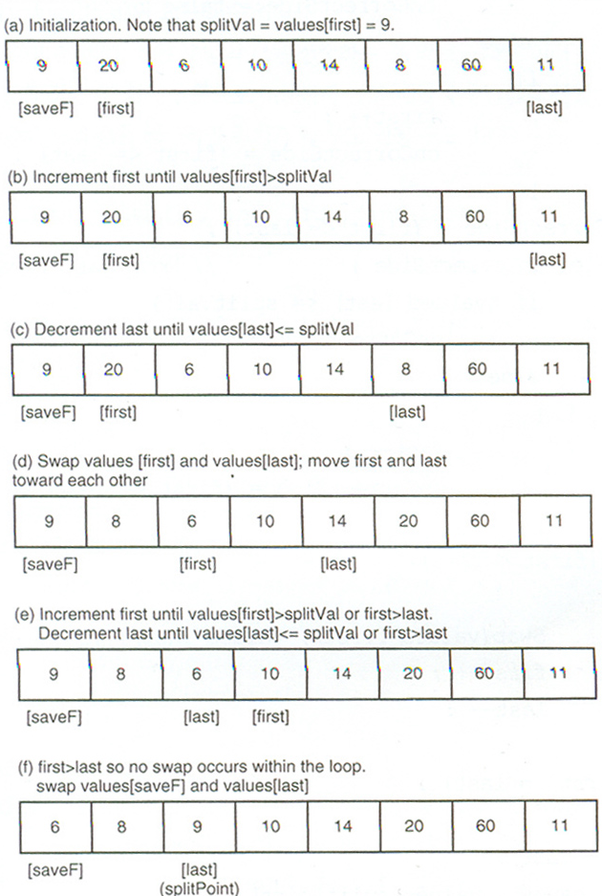
Split function

Slide 42
// Recursive quick sort algorithm
template <class ItemType >
void QuickSort ( ItemType values[ ] , int first , int last )
// Pre: first <= last
// Post: Sorts array values[ first. .last ] into ascending order
{
if ( first < last ) // general case
{ int splitPoint ;
Split ( values, first, last, splitPoint ) ;
// values [ first ] . . values[splitPoint - 1 ] <= splitVal
// values [ splitPoint ] = splitVal
// values [ splitPoint + 1 ] . . values[ last ] > splitVal
QuickSort( values, first, splitPoint - 1 ) ;
QuickSort( values, splitPoint + 1, last );
}
}
42

